Slide 1

Sprocket Central Pty Ltd
TASK 2 – DATA INSIGHTS
Data analytics approach
SHIFA USSUDOOR

Slide 2
Agenda
Introduction
Data Exploration
Model Development
Interpretation

Slide 3
Introduction
New Customer Analysis
Look into these factors in new customers:
Age distributions
Number of bike purchases in 3 years
Job industry category
Customer’s State
Wealth segment
Product size of previous purchase

Slide 4
Data Exploration
Customer Age Distribution
Customers are mostly between 25 to 48 years.
Number of customers from 48 to 59 years old has big drops on percentages.
There is a slight increase in number of customers over 59 years old in term of percentages.
There is no significant change in the percentages of under 25 years.

Slide 5
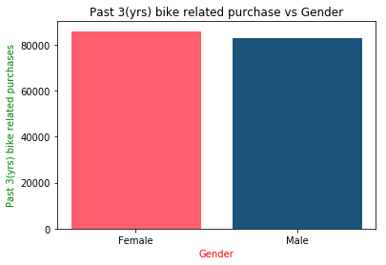
Model Development
Bike purchase in last 3 years
New customers are mostly Female with 50.6% purchases with total of 25,212 bikes.
Male customers contributed to 47.7% purchases with 23,765 bikes
More attention should be put on increasing Female customer with exciting offers.

Slide 6
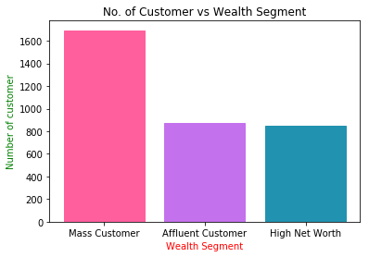
Interpretation
Customer Wealth Segment
The number of Mass Customers is the highest in all the ages. Hence, more focus may be given to this class of society.
The next highest focus on Affluent Customer as it is the next highest in number.
There is a mild difference in high net and affluent customers, so focus on both is required.

Slide 7
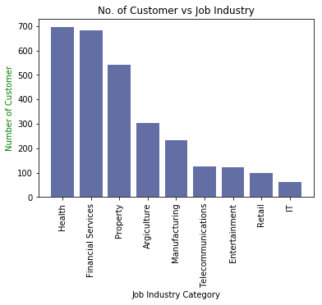
Interpretation
Job Industry Category
Most customers belongs to Health and Finance Services.
Focus to attract health or finance industry and mainly female customers.
There is very lesser chance of a new customer from IT and retail industry.

Slide 8
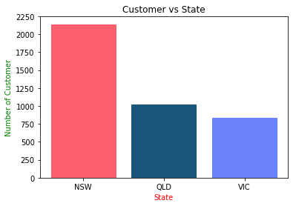
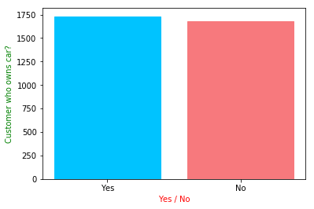
Note: The data and information in this document is reflective of a hypothetical situation and client. This document is to be used for KPMG Virtual Internship purposes only.
Interpretation
Customer State and owns car
Most customers are from New South Wales (NSW)
Also most customers have car.
So, prime focus should be on residents of NSW who owns car.

Slide 9
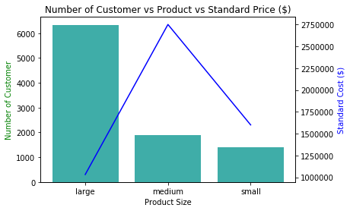
Note: The data and information in this document is reflective of a hypothetical situation and client. This document is to be used for KPMG Virtual Internship purposes only.
Interpretation
Product Size
Large number of customers purchased large size product.
Focus on large size product customers mainly female and resident of NSW.
Also focus on cost of large size product because one of the main reason of their highest selling is low pricing.

Slide 10
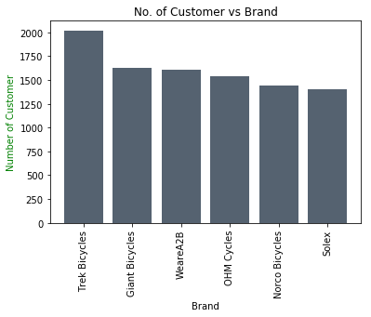
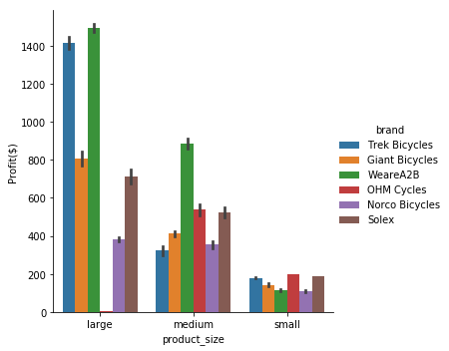
Interpretation
Highest selling brands
Trek Bicycles are highest selling brand in all of brands.
Advertise trek bicycles more with female models
Also all product size of trek cycles are profitable.

Slide 11
Appendix

Slide 12
Appendix
Codes

